Slide 1
Azure AD Application Registration
White
Dark Blue
Hands on Lab
Questions: brand@microsoft.com

Slide 2
Agenda
Azure AD application registration
Language/framework specific guidance

Slide 3
Azure AD Applications

Slide 4
Azure AD Applications
Any application that authenticates with Azure AD must be registered in the Azure AD tenant
Console apps, web apps, services, etc.
Applications in Azure AD are assigned credentials
Client ID: similar to a user’s login / username
Key / secret: similar to a user’s password
Created & managed using the Azure Portals
Also managed using Azure’s PowerShell module / Azure CLI x-platform tool
See: https://azure.microsoft.com/en-us/documentation/articles/active-directory-authentication-scenarios/

Slide 5
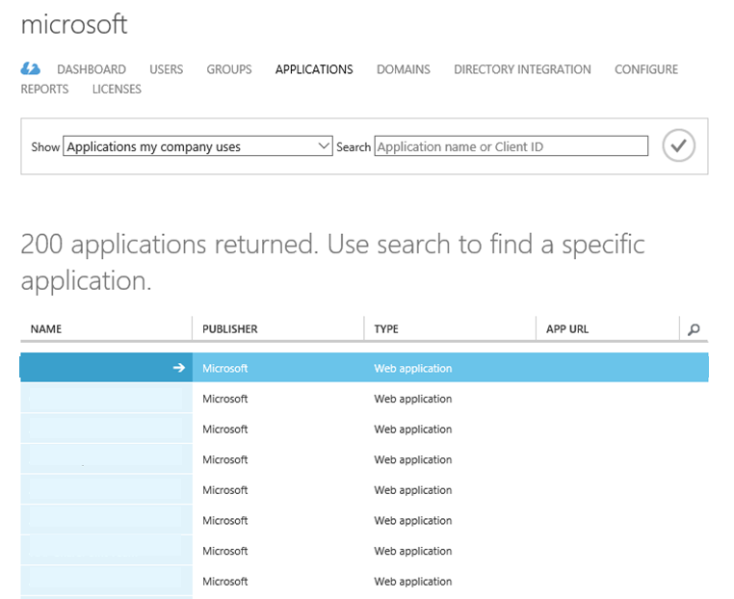
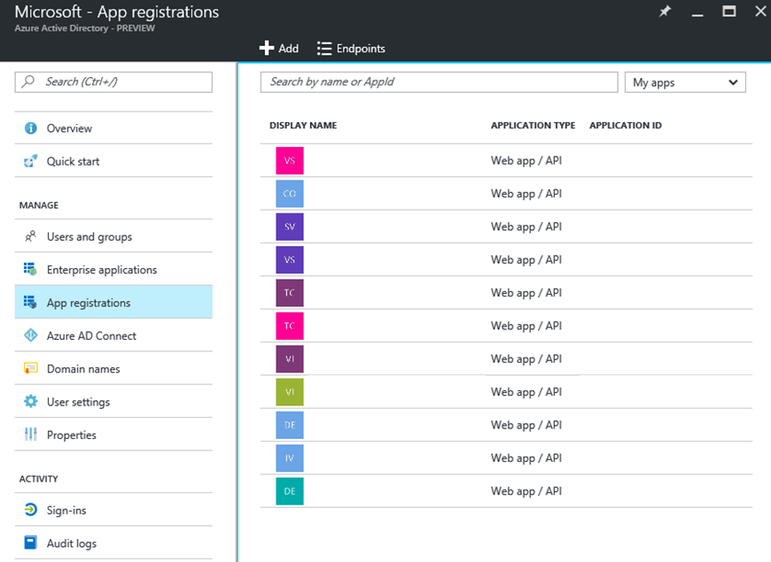
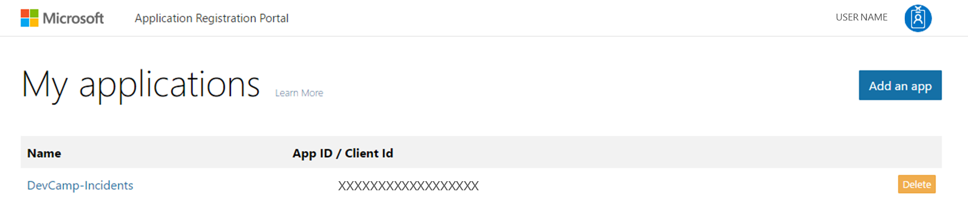
Registering Azure AD Applications
Three Options:
Create Graph 1.0 AAD Applications in Azure Classic
Create Graph 1.0 AAD Applications in New Azure portal
Create Graph 2.0 Applications on apps.dev.microsoft.com
Supports web applications & native applications

Slide 6
Comparing Graph 1.0 and 2.0
https://azure.microsoft.com/en-us/documentation/articles/active-directory-developers-guide/
https://azure.microsoft.com/en-us/documentation/articles/active-directory-v2-limitations/

Slide 7
Single vs. Multi-Tenant Applications
Single Tenant Apps
Available to all users in your Azure AD directory
Not available to users outside your Azure AD directory
Typically internal apps for your organization’s users
Multi-Tenant Apps
Just like single tenant apps except…
Available to all users in any Azure AD directory
Typically built by ISVs or as a SaaS offering

Slide 8
Application Permissions
Delegated Permissions
User of the application consents application specific permission to act on the user’s behalf
User must have permissions the app is configured for delegated permission
Useful in User+App Authentication Scenarios (more later)
Application Permissions
Apps have permissions
Acts independent of user
Must be registered

Slide 9
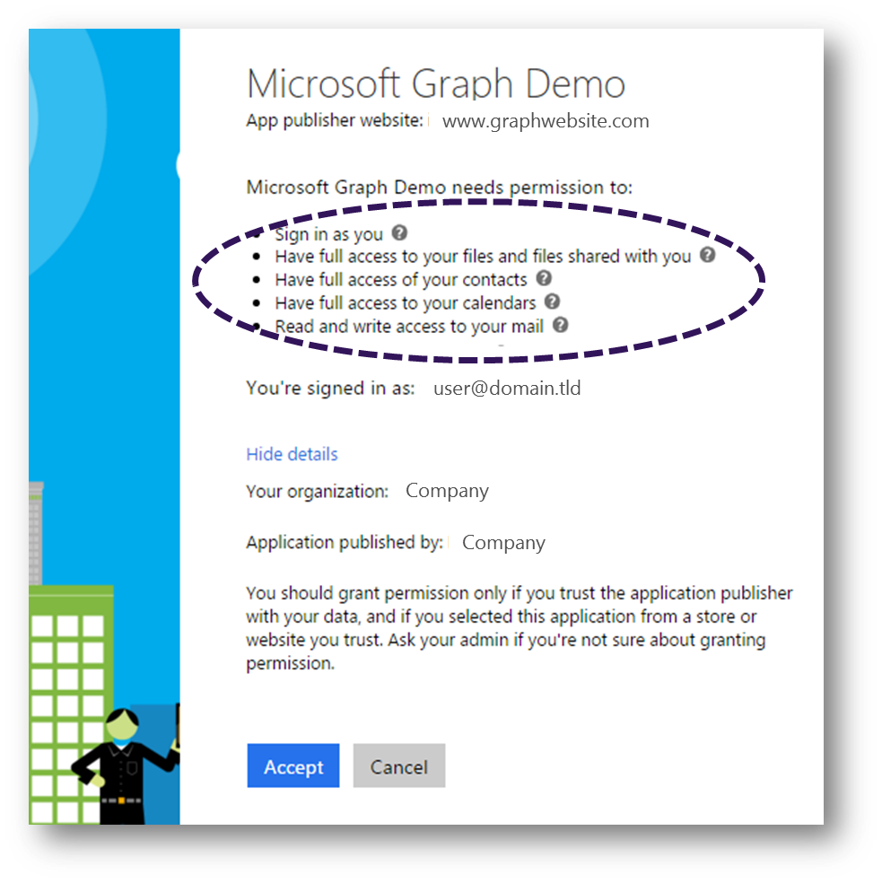
Consent
Single auth flow for accessing all O365 services
Admin and end-user consent
Secure protocol
OpenID Connect and OAuth 2.0
No capturing user credentials
Fine-grained access scopes
Long-term access through refresh tokens

Slide 10
Authorization Flow Review
Authorization
Endpoint
Token
Endpoint
Application
Microsoft Graph API
Request authorization code
Sign-in via browser pop-up
Return authorization code
Redeem authorization code and acquire access token for Microsoft Graph
Return tokens
Call Microsoft Graph using the access token
Return Http Response

Slide 11
Authentication Options
Azure AD only
Separate auth flow supports Azure AD accounts only
Live connect only
Separate auth flow supports Azure AD accounts only
Azure AD and Microsoft Accounts (Preview)
Converged auth flow supports Azure AD accounts and Microsoft accounts (LiveID - hotmail.com, etc.)

Slide 12
Microsoft Account + Azure AD
Many apps want to sign users in from both Microsoft account and Azure AD
Now in preview:
Single endpoint, OpenID Connect and OAuth 2.0
Single SDK
Single end user sign in experience
Single app registration experience
Works with Microsoft Graph
Single API endpoint, business and consumer data

Slide 13
Differences in the converged model
No preregistration of permission scopes
https://login.microsoftonline.com/common/oauth2/v2.0/authorize?client_id=123&scope=user.read mail.read...
Dynamic permission request
https://login.microsoftonline.com/common/oauth2/v2.0/authorize?client_id=123&scope=files.read...
Separate endpoint for admin consent
https:// login.microsoftonline.com/<tenantId>/adminconsent (might change)
Separate endpoint for splitting clouds
https://login.microsoftonline.com/consumers/oauth2/v2.0/authorize?client_id=123&scope=files.read...
https://login.microsoftonline.com/organizations/oauth2/v2.0/authorize?client_id=123&scope=files.read...

Slide 14
Language/framework specific guidance

Slide 15
Azure Active Directory Authentication Libraries
Documentation
https://aka.ms/aaddev
https://docs.microsoft.com/en-us/azure/active-directory/develop/active-directory-authentication-libraries
https://docs.microsoft.com/en-us/azure/active-directory/develop/active-directory-authentication-scenarios
Samples
https://docs.microsoft.com/en-us/azure/active-directory/develop/active-directory-code-samples
https://github.com/Azure-Samples?q=active-directory

Slide 16
Node.JS
Use Passport
Set strategy correctly for the type of flow

Slide 17
.NET
Use OWIN
Beware of dependencies with token parsers
Know your flow
Remember Single vs. Multi tenant
Different libraries for different endpoints
MSAL – 2.0
ADAL – 1.0
Microsoft Graph – 2.0

Slide 18
Client Side JS Libraries
Remember CORS for client side flows

Slide 19
HOL Sample APP

Slide 20
Hands on Lab
Register you app in the correct portal
Add the required libraries to your solution
Integrate your sign in flow

Slide 21

Questions?

